Slide 1
DOMAIN oriented chatbot
Y. Lokesh Kumar (111717031047)
P. Akshay Raj (111717031051)

Slide 2
Abstract
The technology at the core for the rise of the chatbot is “Natural Language Processing” (NLP). Recent advances in machine learning have greatly improved the accuracy and effectiveness of natural language processing. We have developed a domain oriented chatbot which is created by loading the domain related information into the software which we have created. We have used a text document as our corpus. This text document contains domain related data as tag’s, pattern’s and responses. The main issue with text data is that it is un-structured. However, machine learning algorithms need the data to be in numerical form in order to perform the task. So, before we start using the data, we need to pre process the data to make it ideal for work.
The model cannot take the raw data. It has to go through a lot of pre-processing tasks, in order to make it ready for analysis, textual data needs to be pre-processed . The first step is “Tokenization”, in which we break the sentences into words. We tokenize each pattern and add the words in a list. Also, we create a list of classes and documents to add all the intents associated with patterns. Another step is the “Stemming”, which returns the stem of the word.

Slide 3
In the end, the words contain the vocabulary of our project and classes contain the total entities to classify. To save the python object in a file we used the “Pickle” package. These pickle files will be helpful for storing the python objects for the further analysis process. To train the model we will convert each input pattern into numeric form for the process of analysis. First, we will stem each word of the pattern and create a list of zeroes of the same length as the total number of words. We will set value 1 to only those indexes of the inputs that contains the word in the patterns. Same way we will create the output by setting 1 to the class input pattern belongs to. We have used a Deep Neural Network model. We have used Regression algorithm for our Neural Network. After training the model, we saved it. We have assessed the accuracy of the responses given by the chatbot. The average accuracy of the bot was approximately 97.2%.

Slide 4
Existing SYSTEM
Usually chatbots are developed using different kinds of classification methods. It depends on the developers and the amount of data that is available for them. Bots use pattern matching to classify the text and produce a suitable response for the customers. Huge amount of data is required. Most of the tech-giants use self learning chatbots which require huge amount of data through which it can generates accurate responses. A standard structure of these patterns is “Artificial Intelligence Markup Language” (AIML). Similarly, chatbots respond to anything relating it to the associated patterns.
Usually advanced level algorithms like Multinational Naive Bayes, SVM, RNN, LSTM etc.. are some of the algorithms which are used for text classification. For an instance, let’s assume a set of sentences are given which are belonging to a particular class. With new input sentence, each word is counted for its occurrence and is accounted for its commonality and each class is assigned a score. The highest scored class is the most likely to be associated with the input sentence. With the help of equation, word matches are found for given some sample sentences for each class. Classification score identifies the class with the highest term matches but it also has some limitations. The score signifies which intent is most likely to the sentence but does not guarantee it is the perfect match. Highest score only provides the relativity base. There are multiple variations in neural networks, algorithms as well as patterns matching code. Complexity may also increase in some of the variations.

Slide 5
PROPOSED SYSTEM
We have developed a domain oriented chatbot which is useful for small and medium scale industries. This bot requires domain related data to function. We have followed the traditional process of pre-processing of data. We have gathered data from the internet. The data has been framed and stored in a “JSON” file. After the pre-processing tasks like tokenization, stemming and converting the words to lower case. A bag-of-words representation of text is made which describes the occurrence of words within a document. Whenever we want to apply an algorithm on textual data, it needs to be converted into numerical form. We cannot directly feed our text into that algorithm. Hence, Bag of Words model is used to pre-process the text by converting it into a bag of words, which keeps a count of the total occurrences of most frequently used words.
In the end, the words contain the vocabulary of our project and classes contain the total entities to classify. To save the python object in a file, we’ve used the “PICKLE” package.
The architecture of our model will be a Deep Neural Network consisting of 4 layers. It consists of 1 input layer, 1 output layer and 2 hidden layers. We have added an email feature which sends an email to the end user, based on the user query. After we train our model for a certain number of epochs, we saved the model. We have assessed the accuracy of the responses given by the chatbot. The average accuracy of the bot was approximately 97.2%.
Notes:
5

Slide 6
HARDWARE REQUIREMENTS:
RAM: 4GB and Higher
Processor: INTEL i3 and above
Hard Disk: 500 GB minimum
Ethernet connection: (LAN) OR a wireless adapter (Wi-Fi)
SOFTWARE REQUIREMENTS:
OPERATING SYSTEM: WINDOWS 7 and Above
ANACONDA NAVIGATOR 3.6(64-bit GUI) and above
JUPYTER NOTEBOOK
IDLE(Python 3.7 64-bit)
TensorFlow, tflearn to be installed under a separate environment

Slide 7
Design phase
UML DIAGRAMS

Slide 8
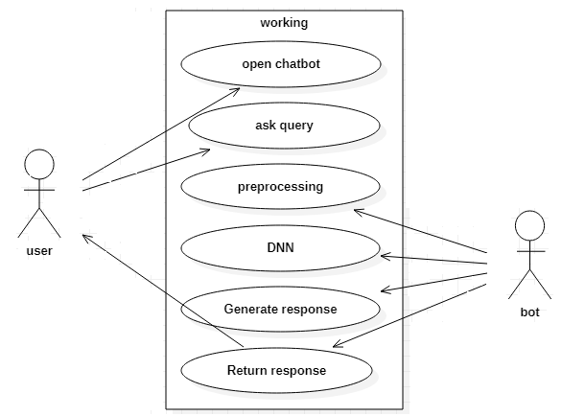
USE-CASE DIAGRAM

Slide 9
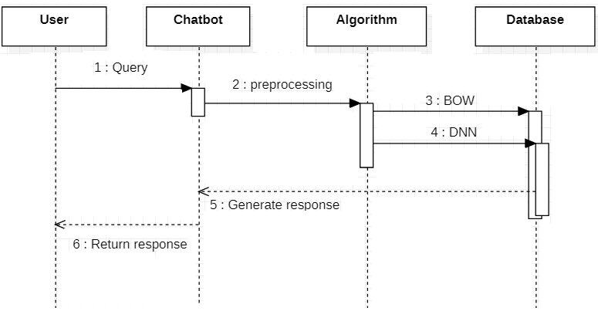
SEQUENCE DIAGRAM

Slide 10
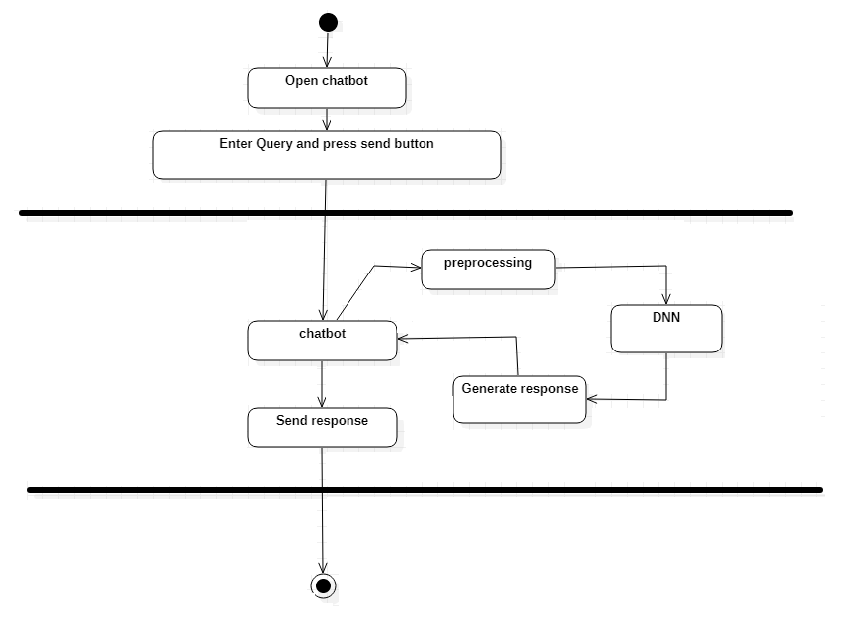
ACTIVITY DIAGRAM

Slide 11
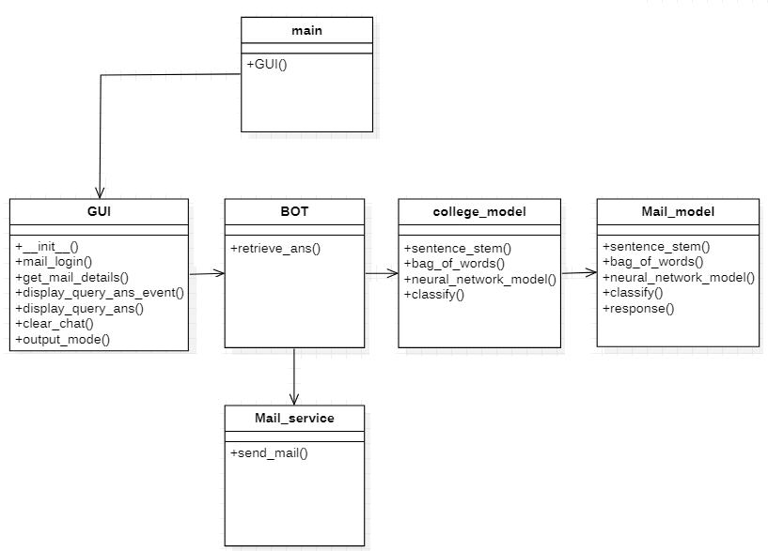
CLASS DIAGRAM

Slide 12
ALGORITHMs
Tokenization
Stemming
Linear Regression
Deep Neural Network model

Slide 13
1. TOKENISATION:
Tokenization is the act of breaking up a sequence of strings into pieces such as words, keywords, phrases, symbols and other elements called tokens. Tokens can be individual words, phrases or even whole sentences. In the process of tokenization, some characters like punctuation marks are discarded.
2. STEMMING:
Stemming is the process of reducing a word to its word stem that affixes to suffixes and prefixes or to the roots of words known as a lemma. Stemming is important in natural language understanding (NLU) and natural language processing (NLP). Stemming is also a part of queries and Internet search engines.
3. REGRESSION:
The regression layer is used in TFLearn to apply a regression (linear or logistic) to the provided input. It requires to specify a TensorFlow gradient descent optimizer 'optimizer' that will minimize the provided loss function 'loss' (which calculates the errors).
4. DEEP NEURAL NETWORK:
A deep neural network (DNN) is an artificial neural network (ANN) with multiple layers between the input and output layers. Each mathematical manipulation as such is considered a layer, and complex DNN have many layers, hence the name "deep" networks. DNNs can model complex non-linear relationships.

Slide 14
PACKAGES
NLTK
NumPy
pandas
TensorFlow
TFlearn
email
smtplib
ssl
Tkinter
pickle

Slide 15
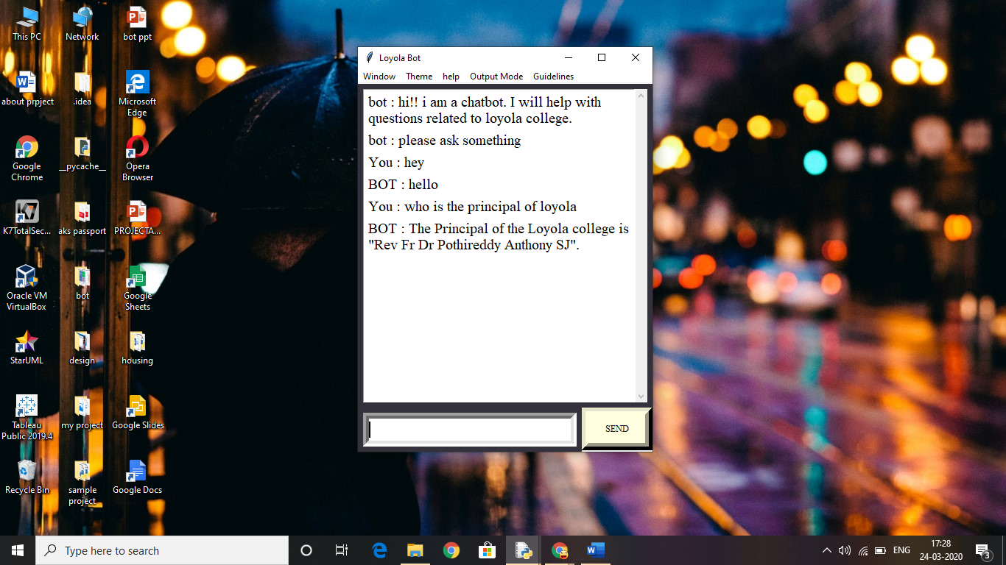
OUTPUT SCREENS

Slide 16
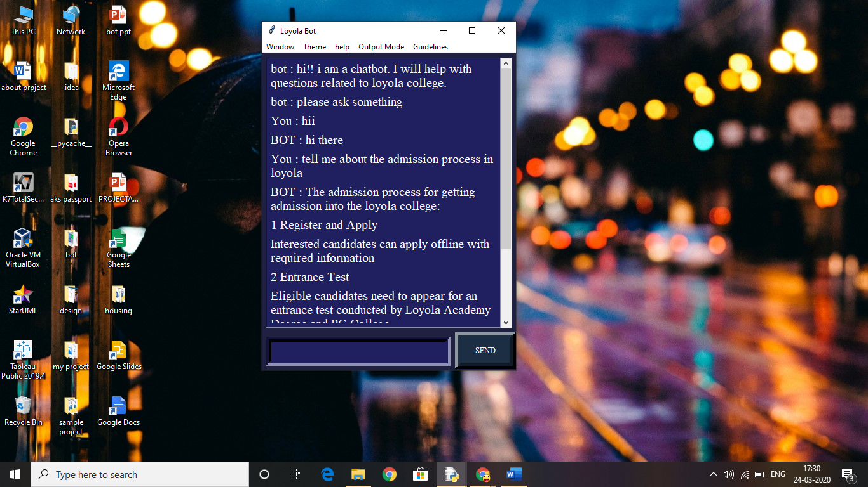

Slide 17
CONCLUSION
From the responses we can conclude that the model fitted to the chatbot is working well. It is responding with the appropriate responses. The deep neural network learns from the data provided and generates an appropriate response. This chatbot is mainly dependent on the amount and accuracy of the data that is fed. So, it is the business organization which provides the data to the software developers to get a chatbot deployed for themselves.
The NLTK module in python helps to handle the Natural Language Processing tasks. The pre-processing part helps to Standardize the words in the query. These standardized words are then compared with the data in the database or document, which returns the top most matching result with the help of the model fitted.
The model used here is the Deep Neural Network. We can also use Gradient boost, Adam etc.,. algorithms to optimize the model. As the Deep Neural Network is simple to implement and generates better response compared to other models , we have chosen it for fitting the machine learning model. Finally, we conclude that the chatbot we have created is responding well with the amount of data that is fed and the model (DNN) we have fitted to it.

Slide 18
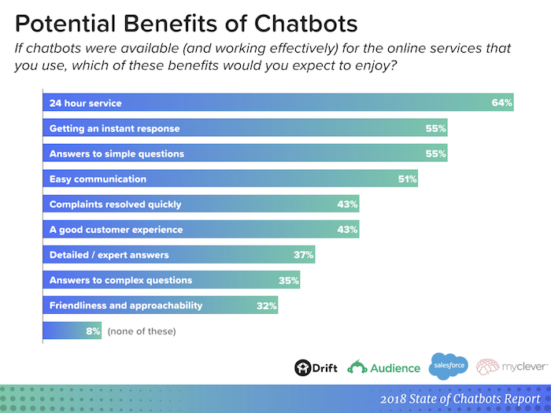

Slide 19
FUTURE SCOPE
A chatbot is a service, powered by rules and artificial intelligence that you interact with via a chat interface. These computer programs are designed to resemble human conversations. For example, Facebook Messenger, Siri, Alexa, Cortana etc.
The pressure to yield maximum result with minimum resources is the main aim of business industries. Small and medium scale industries could not have much of the resources. So, they rely on quick results and anything that can pay for itself is an asset. Chatbot can act as an asset for these kinds of industries. Brands can use it to improve their customer's experience, to generate more sales and build a deeper rapport with customers. They allow your customers to easily interact with your brand through stimulated conversations.
Although creating a chatbot is easy, creating a profitable chatbot will take time and effort. It's possible that someone who have already used a chatbot, but have no clue how to make a profitable one. Successful chatbots can generate several thousand dollars a month in various ways. Automation and AI could look rocky to a small or medium business owner. However, exploring and incorporating the chatbots could turn the Revenue of business industries high up.
We have created a Chatbot for a college which could ease the students to access the information about the college. This helps the college to attract more number of students and provide better service to the existing ones.

Slide 20
